Slide 1
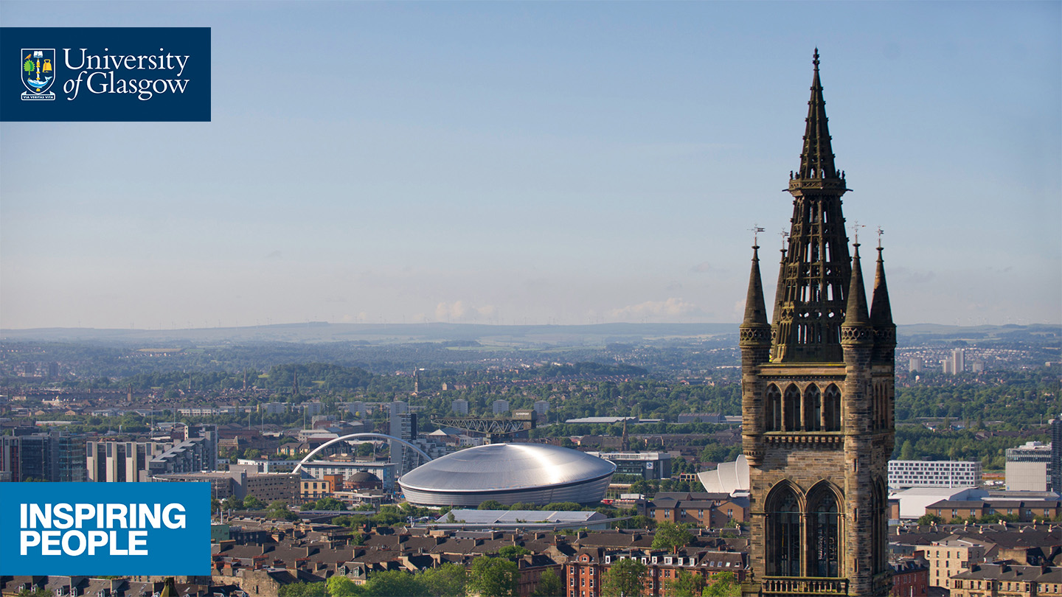

ROBERT BURNS AND THE SCOTTISH ECONOMY
Professor Murray Pittock, Pro Vice-Principal, Centre for Robert Burns Studies
Funded by Scottish Government, Economic Development Directorate (Enterprise and Cities)

Slide 2
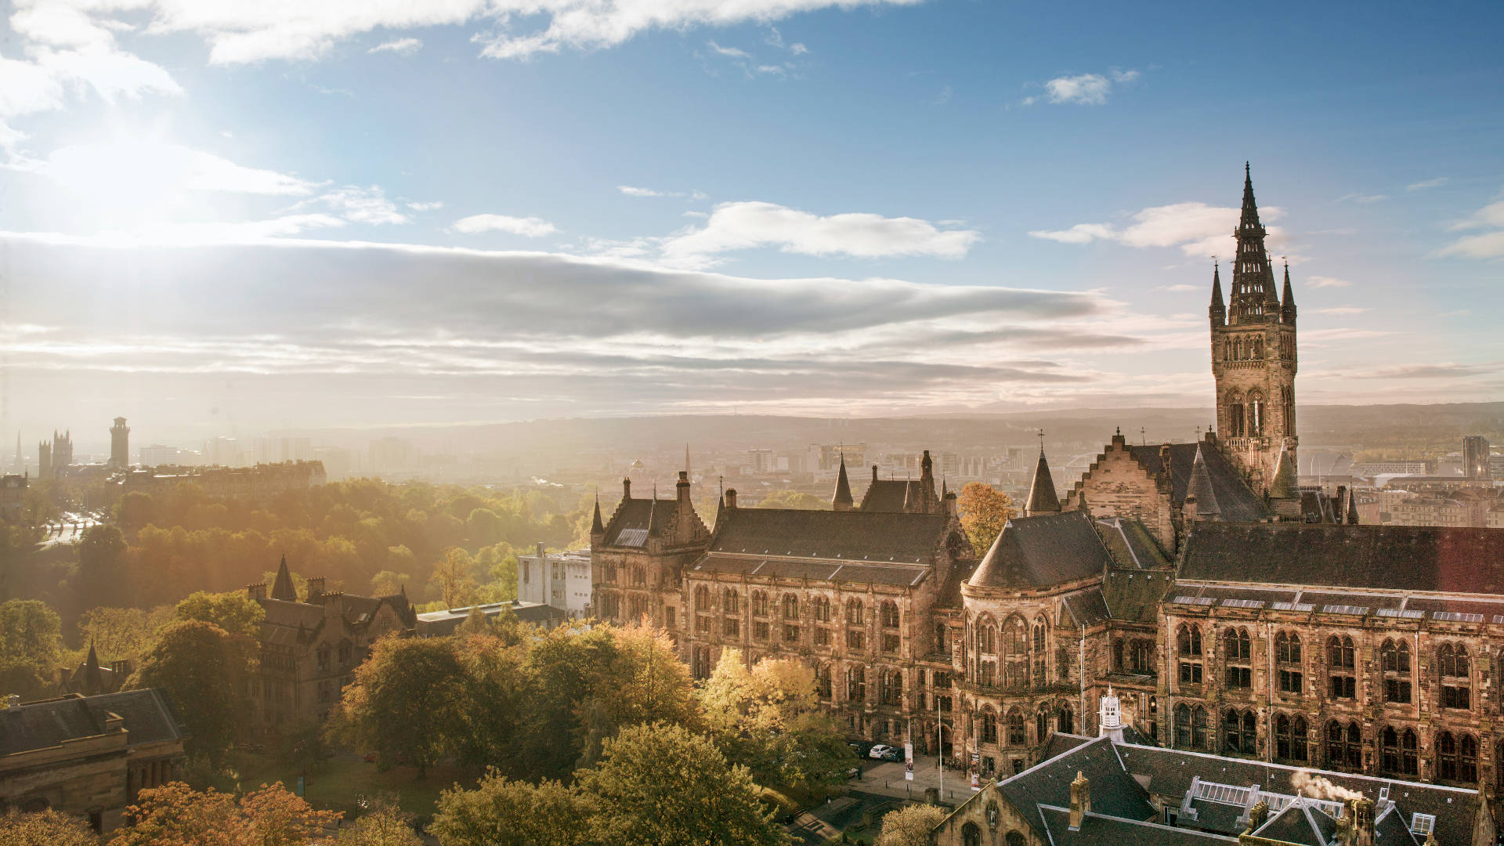
  INTRODUCING THE PROJECT
  Previous funded Burns projects include: AHRC Global Burns Network, the first major funded project in the Centre for Robert Burns Studies, AHRC Robert Burns Beyond Text: Inventing Tradition and Securing Memory; AHRC Editing Robert Burns for the 21st Century (Co-Investigator); EPSRC-AHRC Scottish Heritage Partnership and now Robert Burns and the Scottish Economy
  2001 study by Lesley Campbell for David Stenhouse at the BBC: £157M
  2005 update on that study for 2009 Homecoming planning by Moffat Centre, GCU
  2018 members’ debate in Scottish Parliament initiated by Joan McAlpine MSP on 17 January 2018, S5M-09328, ‘The Economic Potential of Robert Burns’.

Slide 3
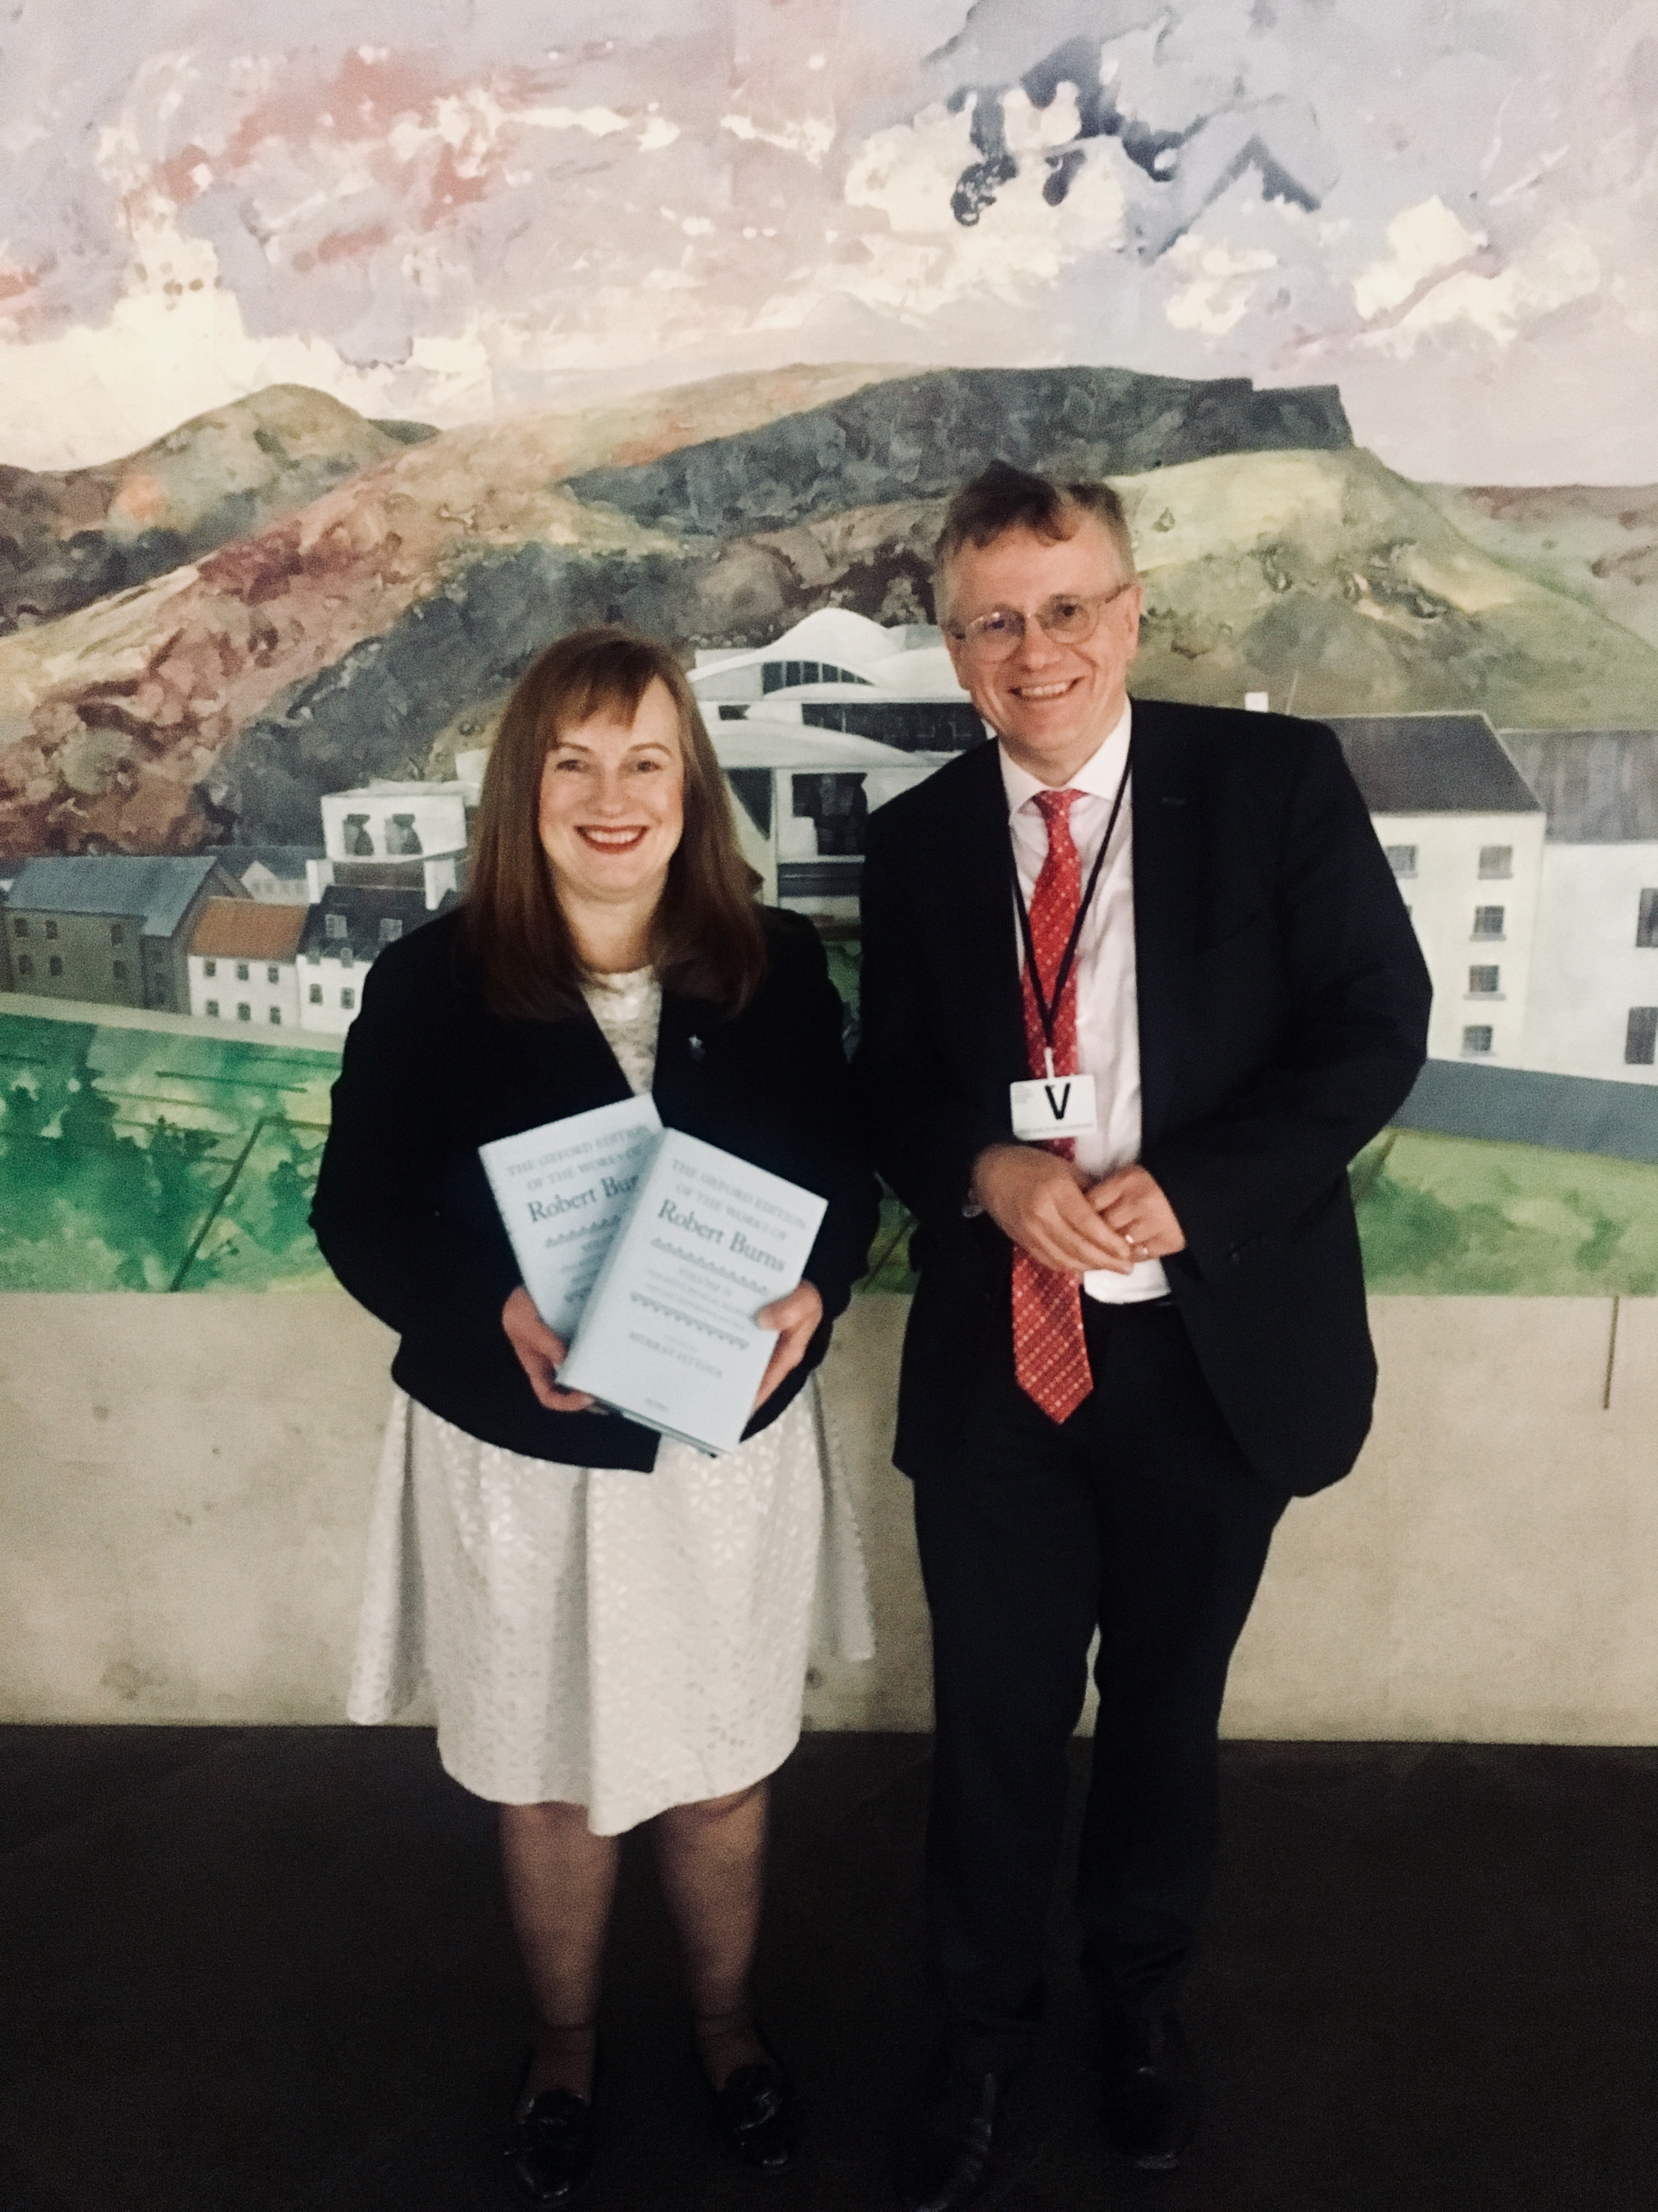
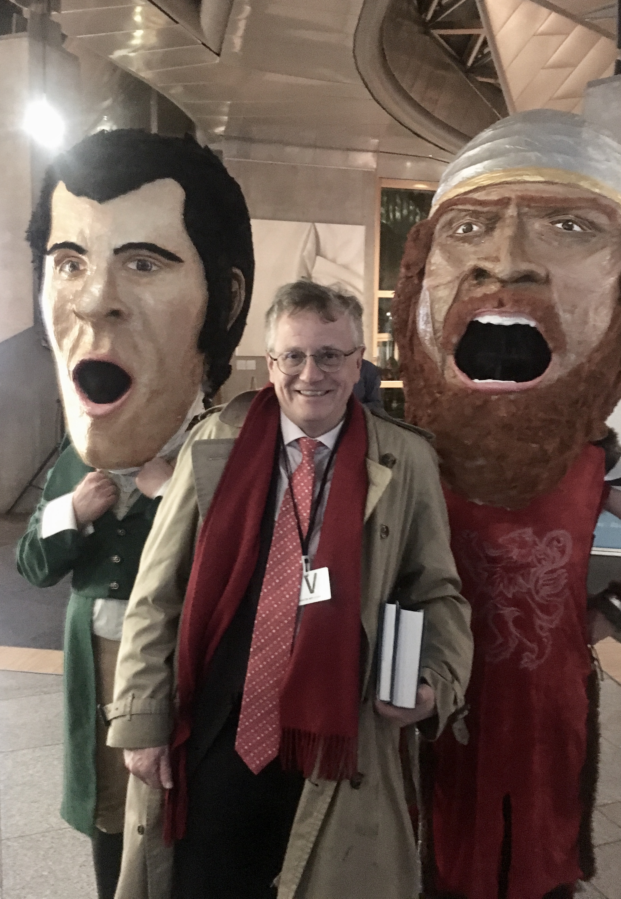
  INTRODUCING THE PROJECT
  Previous funded Burns projects include: AHRC Global Burns Network, the first major funded project in the Centre for Robert Burns Studies, AHRC Robert Burns Beyond Text: Inventing Tradition and Securing Memory; AHRC Editing Robert Burns for the 21st Century (Co-Investigator); EPSRC-AHRC Scottish Heritage Partnership and now Robert Burns and the Scottish Economy
  2001 study by Lesley Campbell for David Stenhouse at the BBC: £157M
  2005 update on that study for 2009 Homecoming planning by Moffat Centre, GCU
  2018 members’ debate in Scottish Parliament initiated by Joan McAlpine MSP on 17 January 2018, S5M-09328, ‘The Economic Potential of Robert Burns’.

Slide 4
  THE IMPORTANCE OF TOURISM
  Estimated impact of Burns tourism, 66% of economic value (Moffat Centre)
  Cultural tourism: The 2013 Centre for Economics and Business Research (CEBR) study on Arts, culture and the national economy identified 32% of all inbound visits to the UK as involving Arts and culture engagement and 42% of all inbound spend (£7.6 billion).
  CEBR included an average £26817 uplift in house prices for houses in areas with twice the average level of cultural density. Given an average house price of £226000 in 2013, that suggests a rise of 12% in house prices for every doubling of cultural density. Houses sold in protected historic landscapes (with particular cultural density) are worth 28% more on average.
  For every £1 of Gross Value Added generated by the arts and culture industry, an additional £1.43 of GVA is generated by the wider UK economy.

Slide 5
  WHAT IS THE PROJECT MEASURING AND WHEN WILL IT REPORT 1?
  Economic Impact of Burns related tourism in its core areas and elsewhere as far as possible
  Economic Impact of Burns festivals
  Food, drink and retail value by
    Enhanced consumption in season, Explicit Burns related linkages, seasonal kilt hire, benefit to domestic produce, music sales, book sales, themed boxes, explicit branding (e.g. Arran Distillery)
  Scale of community and education Burns-related activity, charity fundraising
  Scale of Burns’ global footprint: e.g. 1.2M YouTube views for ‘A Man’s a Man’, almost 1M for ‘Trotz Alledem’. 9m attendees at 9000 official suppers

Slide 6
  WHAT IS THE PROJECT MEASURING 2
  Existence value: views of the value of Burns (cf the Bolton Libraries and London Olympics studies).
  The Psychic Economy: Golf courses and swimming pools in remoter areas are between three and four times as likely to be used by tourists as those in urban areas (System Three 1998), thus maintaining a higher level of local facility at a lower cost than would otherwise be possible. Sustainability issues.
  Brand value: Burns influences the international perception of what constitutes the Scottish brand, through the Anhalt-GfK Roper index. Burns suppers and statuary are spread throughout the world, and the use of Burns’ name by brands such as Coca-Cola (2009), Riviera Travel (2017) and Norwegian Airlines (2018) indicate its levels of recognition and perceived transferable global value.

Slide 7
VISITING BURNS: SINGLE FIGURE TOURISM IN SCOTLAND
Over 100 000: John Muir (birthplace and country park) 453; Robert Burns Birthplace Museum 164; Wallace Monument 139.
Over 50 000: Scott Monument 81; Abbotsford 61; Writers’ Museum (Burns, Scott and Stevenson) 59
Over 20 000: Robert Burns Centre Dumfries 32.5; Mary Queen of Scots Visitor Centre 32; Hill House 28.5.
Over 10 000: Robert Burns House 12; House for an Art Lover 11
Over 5000: Burns Monument Centre Kilmarnock 9; Holmwood House (Thomson) 5.5
Under 5000: Burns Museum Mauchline 4.5; Hugh Miller’s Cottage 4.2, Scott’s Courtroom, Selkirk 4; Souter Johnie’s Cottage, Kirkoswald 3.5; Barrie Birthplace Kirriemuir 2.1;Fair Maid’s House, Perth (Scott) 2; John Paul Jones House 2; Leighton Library, Dunblane 1.8; Ellisland 1.6; Bachelor’s Club, Tarbolton 1.2; Carlyle’s birthplace 0.8, Burns Monument Edinburgh 0.7

Slide 10
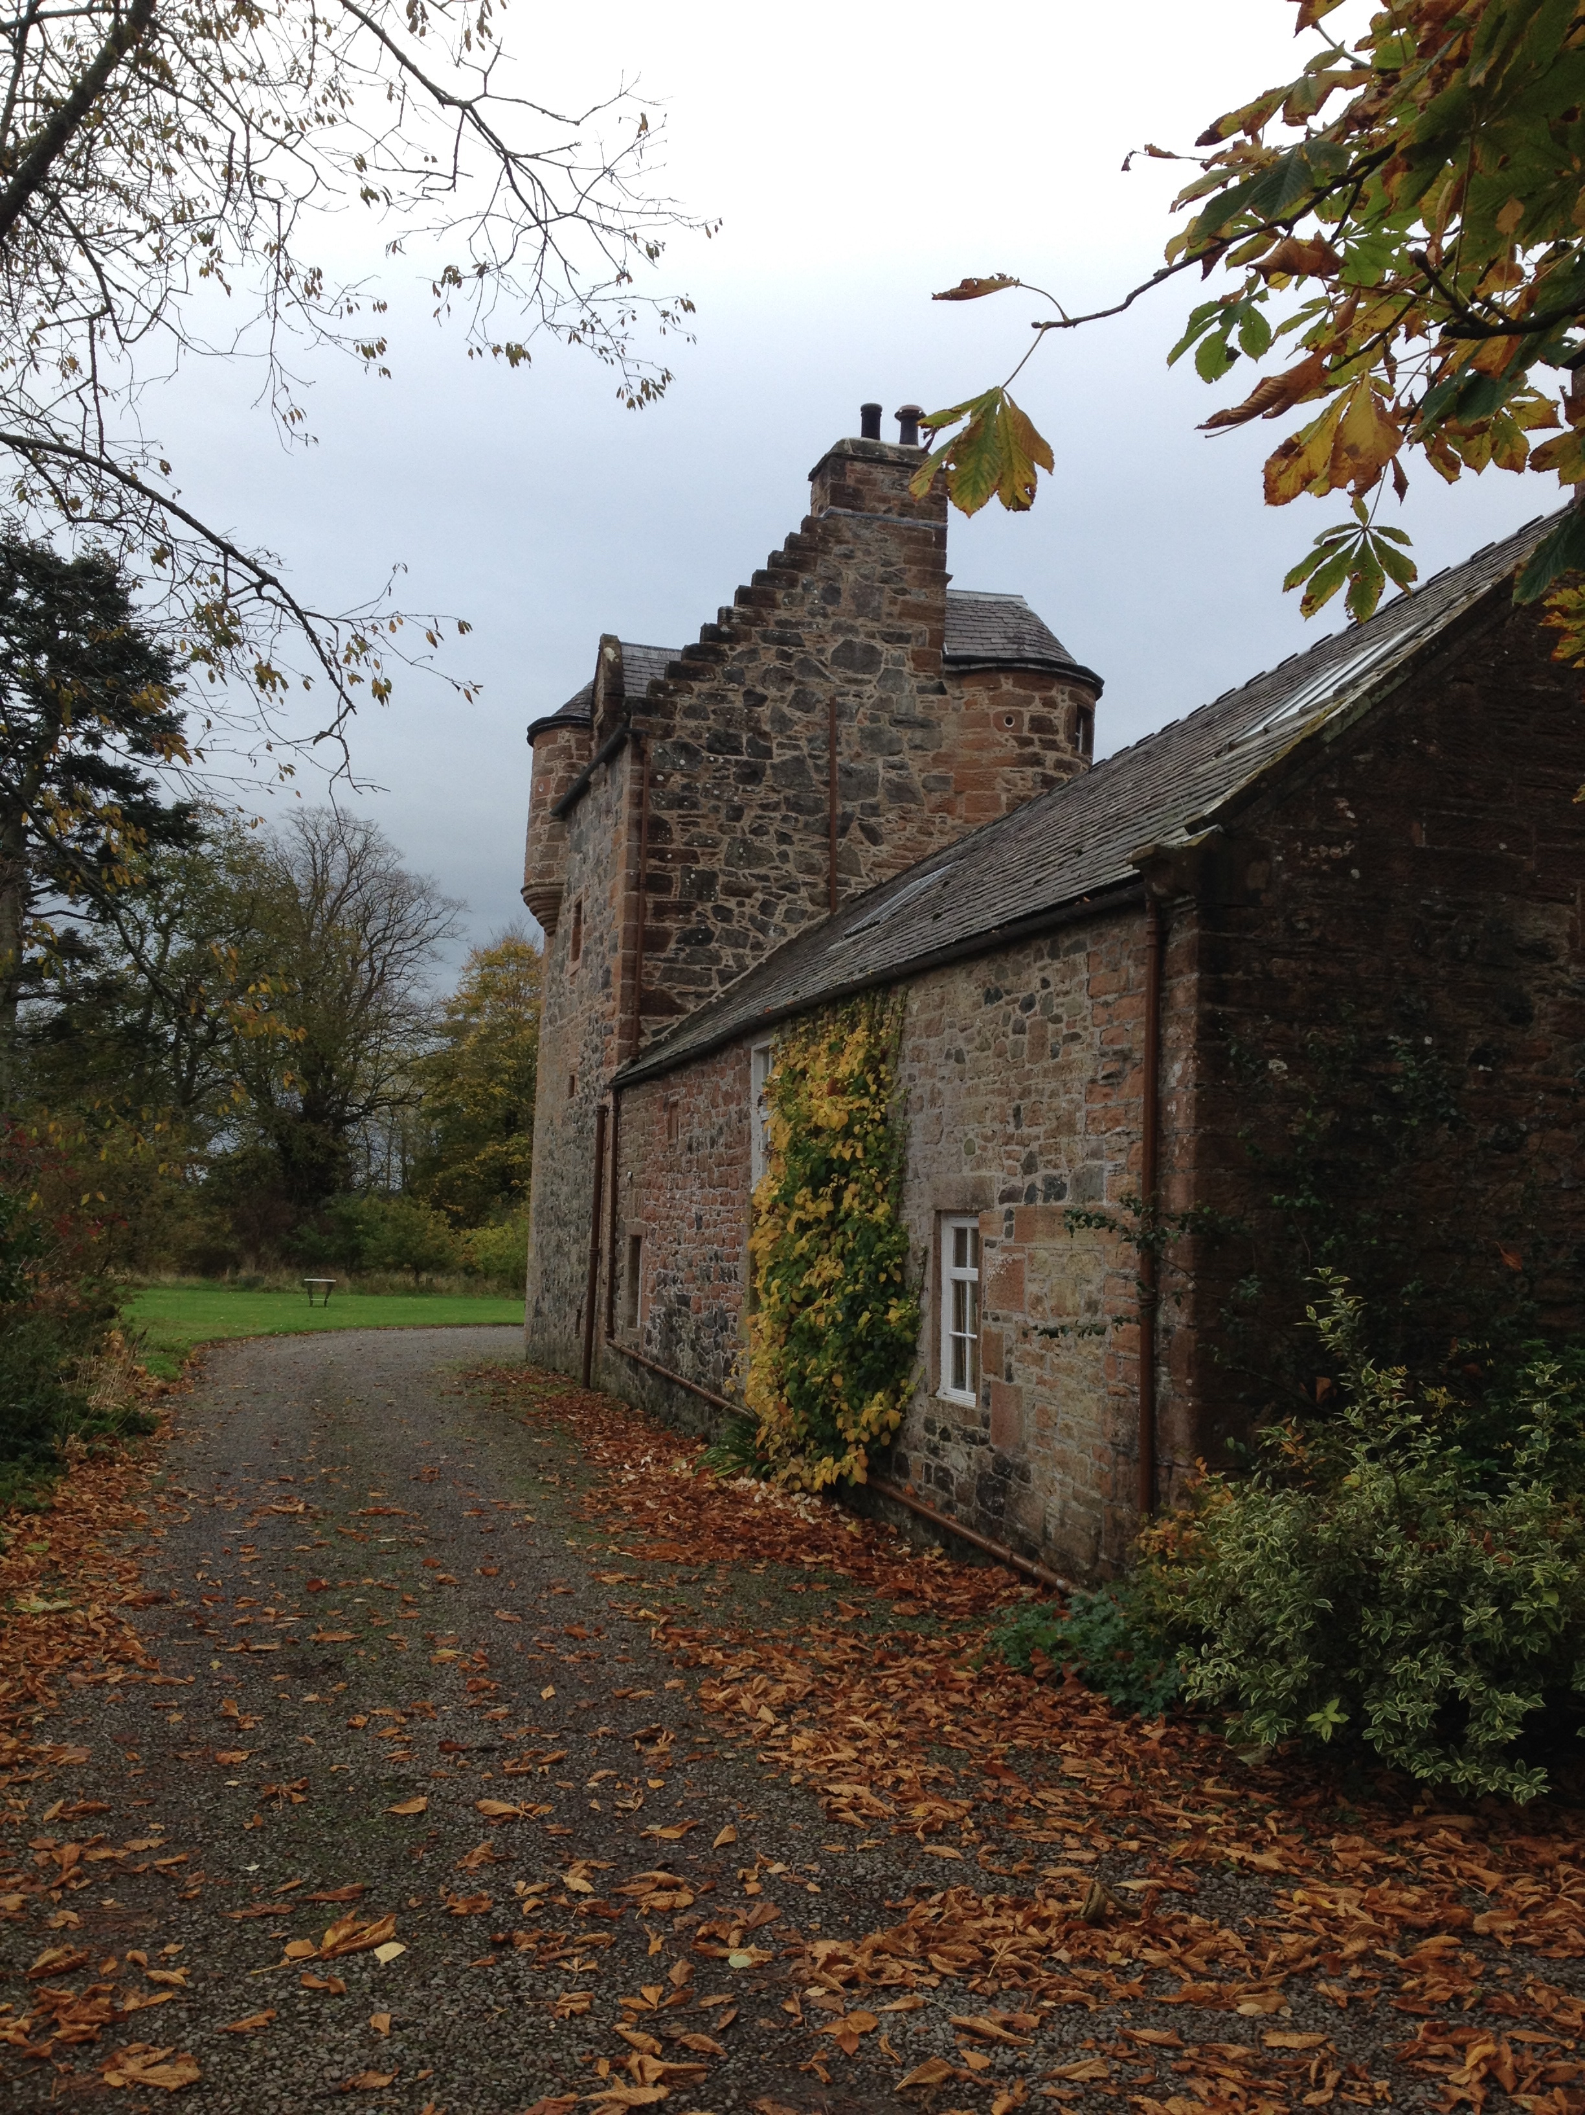

Slide 11
  BURNS IN DUMFRIES AND GALLOWAY 1
  In 2017, there were 2.571M visits to D & G, amounting to 5.15M visitor days/ Aggregate economic impact was £331M
  23.9% (615000) stayed in serviced accommodation for an average of 1.67 days, generating £123.40 per visitor day in economic impact and supporting 2868 FTE jobs in aggregate
  15.8% (406000) in non-serviced, for an average of 5.61 days, generating £52.69 per visitor day and supporting 1862 FTE jobs in aggregate
  7.2% (186000) stayed with friends and relations, for an average of 4.55 days, generating £21.42 per visitor day and supporting 211 FTE in aggregate
  53.1% (1.365M) were day visitors, generating £48.53 per visitor and supporting 779 FTE.

Slide 12
  BURNS IN DUMFRIES AND GALLOWAY 2
  Visitor numbers down 11% since 2009, but up 6% in serviced accommodation
  The main issue has been a heavy decline in day visitor numbers and days, down almost 25% in the same period.
  D & G Strategy targets Providing Authentic Experiences as important: the Provenance issue with food, drink and museums/culture/heritage
  Burns is not mentioned in the Strategy document explicitly however, and that is equally true of other figures with a strong connexion with the region. This is an approach which stands in contrast with that of Ayrshire and Arran.

Slide 13
  BURNS IN DUMFRIES AND GALLOWAY 3
  Burns-related attraction in Dumfries: 46100 visits, 2.25% of all attraction visits in Dumfries and Galloway in 2017. Taken in isolation as a raw number, this would represent 1.8% of all D & G economic impact, some £2.38M. However, this almost certainly underestimates the number of visitors who come to Dumfries and Galloway because of Burns, but no data appears to exist for this. By contrast, in Ayrshire and Arran, Burns is the top reason for visiting.
  There is scope for major growth: Ellisland (current visitor numbers 1600) has the goal of reaching 28000 visitors following the implementation of a new plan, and turnover is already rising. Newhailes in Musselburgh attracted the same number of visitors to its new WeeHailes facility in its first weekend as come to the house itself in a year.

Slide 14
  RECOMMENDATIONS?
  Important to be aware of the very limited economic benefits derived from local festivals. Most festivals attract a disproportionately high number of day visitors, whose spend is lower and more likely to represent displaced expenditure which would have taken place anyway, even if elsewhere in the region in question or at another time. Psychic income is the chief benefit.
  BOP Edinburgh Festival Impact study discounts the economic impact provided by home day visitors to only 3% of their spend. In this way, such Festivals have similar levels of displacement to museum visits within Scotland: in calculating economic impact in Glasgow, 95% of day visitor spend is deemed to be displaced for example. The environmental costs incurred by short distance visits are also not insubstantial.

Slide 15
  INTERIM RECOMMENDATIONS FROM RESPONDENTS 1
  Renaming Prestwick Airport: the options
  Improved signage off M74
  In county signage: it was strongly felt that the existing exit signage to Dumfries and Ayr does not promote tourism sufficiently. In addition, Dumfries and Galloway respondents focused on a particular lack of Burns signage in their area.
  The development of a more integrated Burns trail across the areas covered by the Ayrshire Growth Deal and SoSEP was strongly supported by a range of respondents. It was recognized that information respecting Burns and Burns-related sites should be integreated into information relevant to other areas, e.g. Ayr town centre redevelopment or a Greenock-Irvine John Galt related walkway and cycle path.

Slide 16
  INTERIM RECOMMENDATIONS FROM RESPONDENTS 2
  School curriculum: there was a widespread view (ranging from RBWF to BEMIS) that Burns was not-as other national poets might be-recognized and emphasized sufficiently in the school curriculum.
  Joint ticketing across Burns attractions in both Ayrshire and Arran and Dumfries and Galloway was mentioned by some respondents: the idea of a 7-day Burns Pass or similar (possibly involving catering and other service industry discounts) was seen as beneficial to widening the spread of visitors from major attractions such as the Birthplace Museum to some of the adjacent but much less visited attractions
  Additional recommendations will arise from the research

Slide 17
  Murray.Pittock@glasgow.ac.uk
  @P14Murray
  @GlasgowBurns

