Slide 1
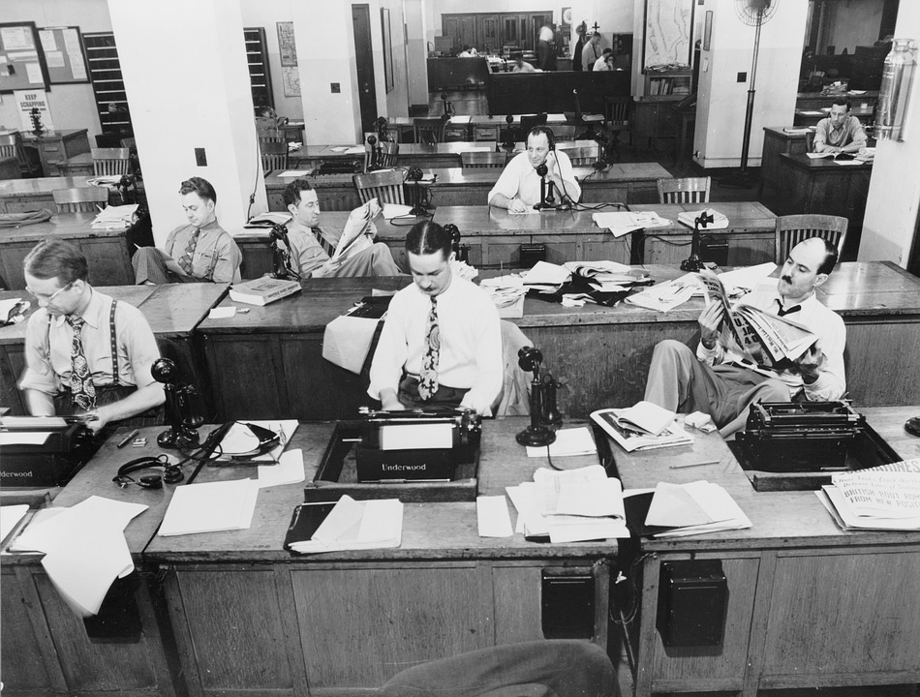
The news in trouble
Frances Cairncross

Slide 2
Why news matters
“Were it left to me to decide whether we should have a government without newspapers or newspapers without a government, I should not hesitate a moment to prefer the latter. But I should mean that every man should receive those papers and be capable of reading them.”
  Thomas Jefferson, 1787

Slide 3
The question: How to sustain the provision of high-quality news?
Newspapers face two destructive trends:
    Advertising revenue dwindling
    Newspaper readership is sinking rapidly

Slide 4
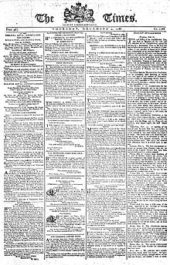
A dramatic loss of print advertising
Advertising has been the bedrock of newspaper finances for more than two centuries
Led by classified. Internet
allows “unbundling”, and more
precise searches.

Slide 5
Where small firms advertise
Frances Cairncross | Enders Analsyis | September 2018
5
Notes:
5

Slide 6
A huge blow:
Online classified advertising rose almost ten-fold from 2004 to 2017
Hurting local and regional papers
most: in 2010, classified advertising was 56% of total advertising revenues
But only 14% for national titles.

Slide 7
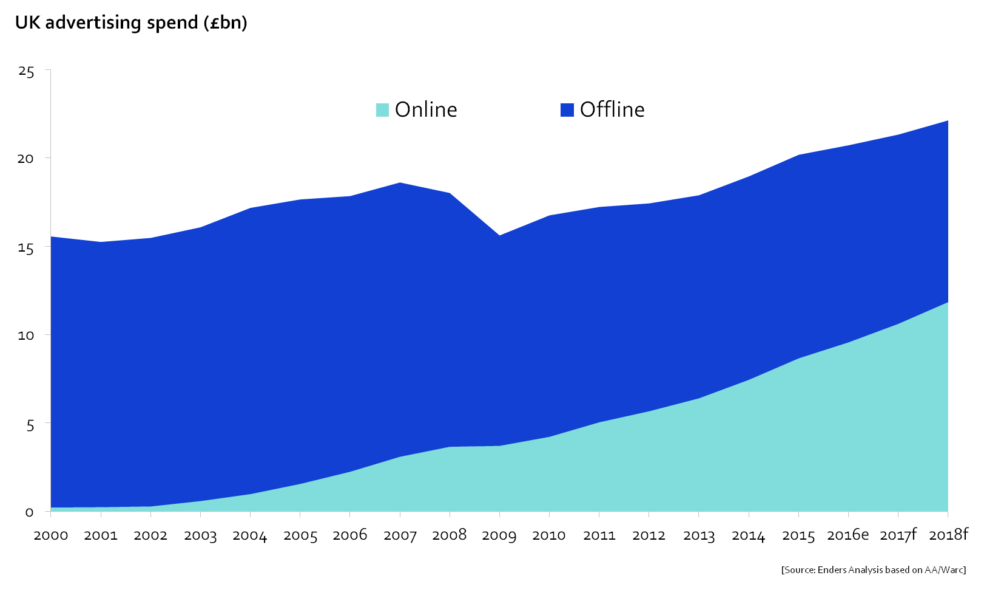
Over 50% of advertising spend is digital
Frances Cairncross | Enders Analsyis | September 2018
7

Slide 8


Now, growing loss of display ads
The impact especially of Google and Facebook
Both know far more
about readers than
papers do – and
that is where readers
increasingly go…

Slide 9
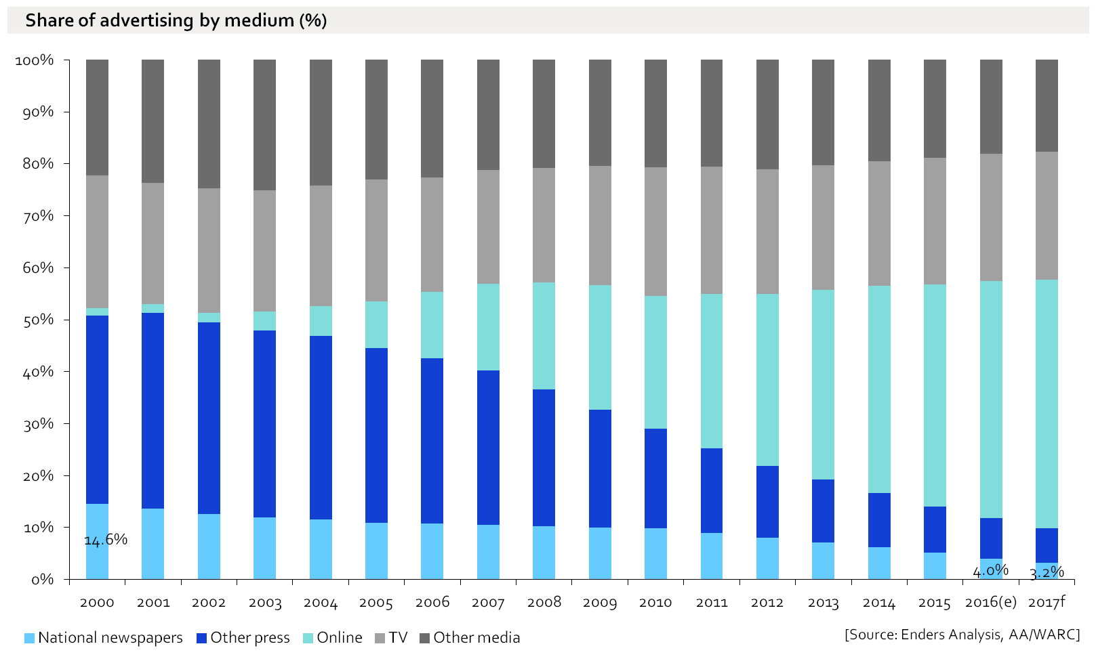
Other media are less hurt
Frances Cairncross | Enders Analsyis | September 2018
9
Notes:
9

Slide 10
The second trend: falling readership
Compounds and aggravates the loss of advertising
For nationals, the biggest squeeze on mid-markets like the Mail and the Express
Especially serious among the young

Slide 11
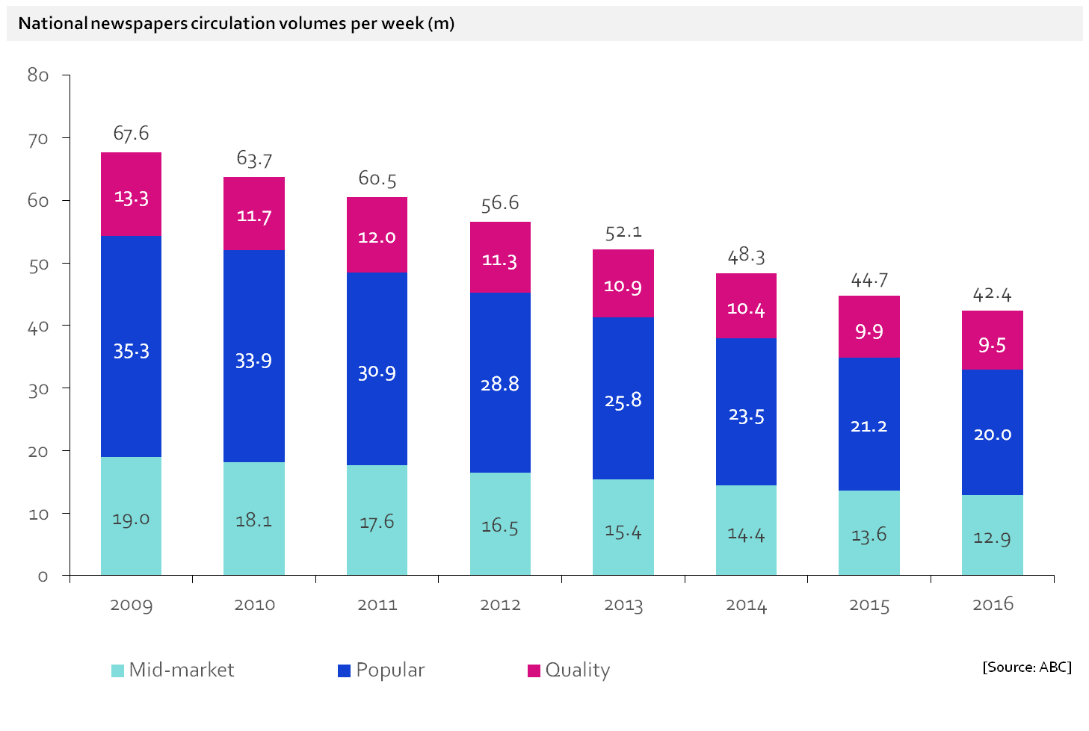
National newspaper circulation
2014-2016
-9%
-15%
-10%
Frances Cairncross | Enders Analsyis | September 2018
11
Notes:
11

Slide 12

Has accelerated with the advent of smartphones

Slide 13
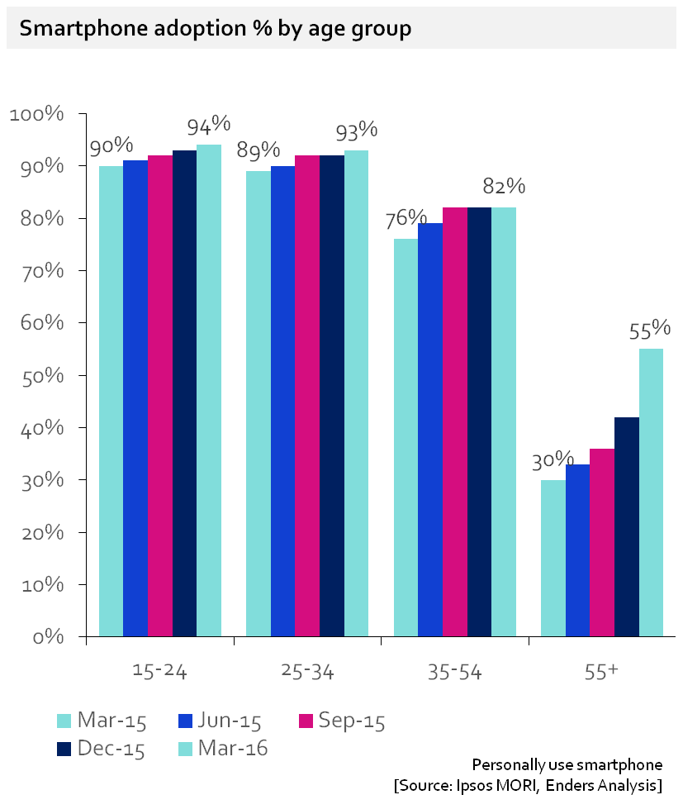
Decline of daily print news: smartphones the killer blow
Frances Cairncross | Enders Analsyis | September 2018
13
Notes:
13

Slide 14

Mobile phones take up time
…though they also deliver news….

Slide 15
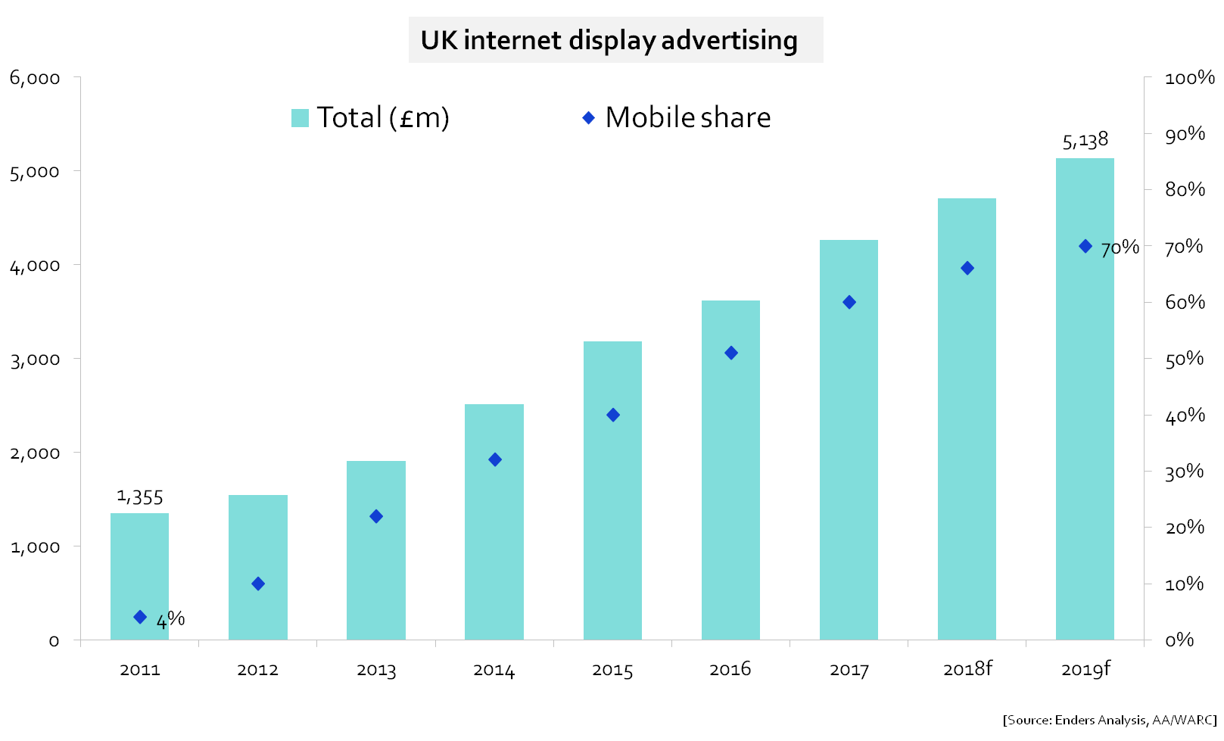
Mobile’s rising share of ads
Frances Cairncross | Enders Analsyis | September 2018
15

Slide 16
Paper pounds to digital pennies
People – especially the young – increasingly reading news online
But how to make money from this?
The main news website is free
Readers reach news sites mainly through Google and Facebook
They collect most of the advertising spend

Slide 17
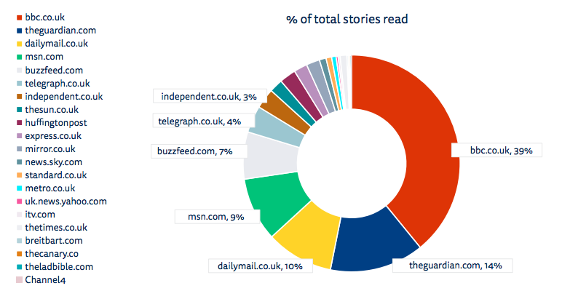
The main news website is free

Slide 18
Top digital sites by time
Frances Cairncross | Enders Analsyis | September 2018
18

Slide 19
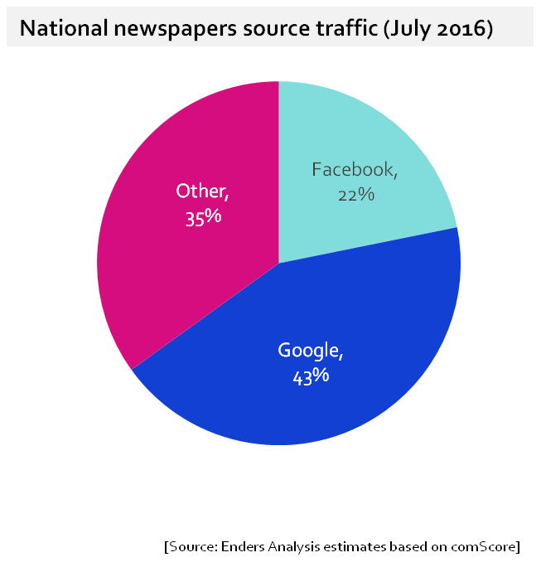
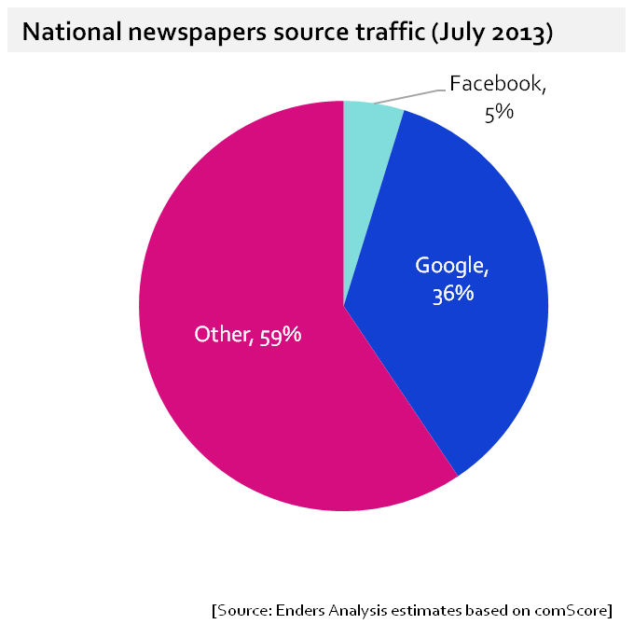
Two thirds of digital readers of news come via Google and Facebook
Frances Cairncross | Enders Analsyis | September 2018
19

Slide 20
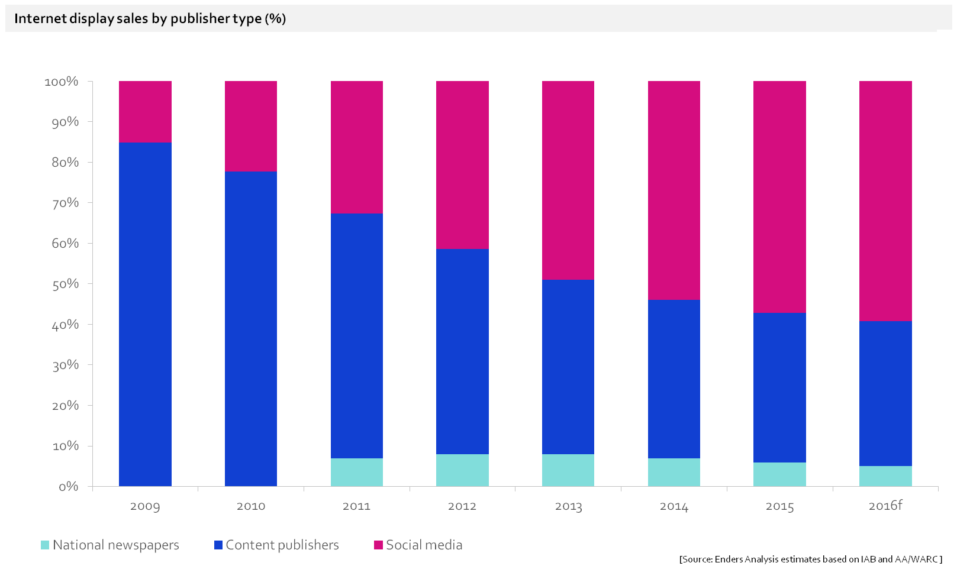
Newspapers tiny in digital advertising: 5% share and falling
Frances Cairncross | Enders Analsyis | September 2018
20

Slide 21
Who gets the ad revenue
Estimated gross UK online ad spend by media owner in 2017
Amazon
Twitter
Google
(£5.9bn)
Facebook
(£1.7bn)
News brands
<4% of total
Oath
Snap
[Source: Enders Analysis estimates]
Frances Cairncross | Enders Analsyis | September 2018
21

Slide 22

So what are the solutions?

Slide 23
Several conclusions…
Newspapers will continue to dwindle
We may need transitional help to moderate their decline
But we also need to think about how news will be digitally delivered in future
Some news is a public good. Societies usually relay on public money to guarantee supply of public goods
But should government fund public interest news? Should charity law be altered?

Slide 24
In addition….
We need to review the role of big platforms – Google and Facebook. EU has already begun…
But people may also have to pay for news
The good news:
  1. News groups are collaborating more
  2. Some signs that people might pay

Slide 25
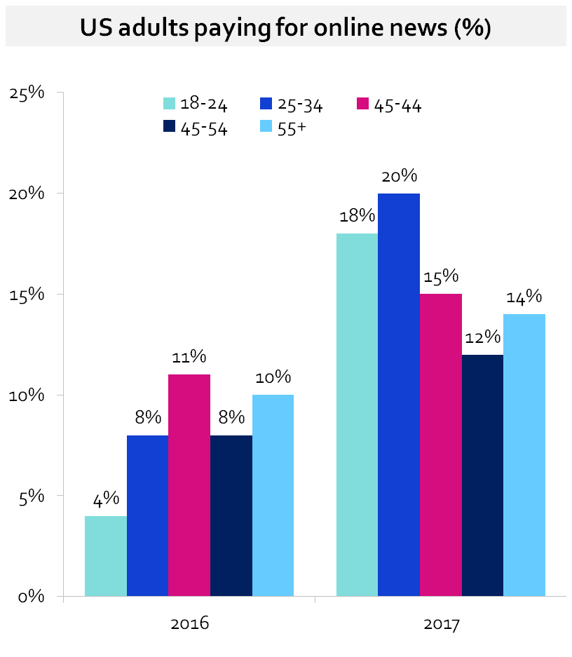
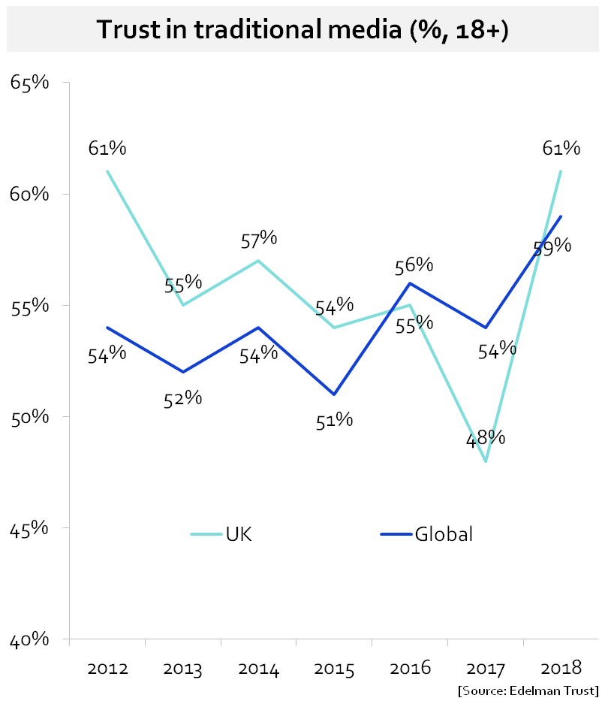
Trust in news media growing -& willingness to pay
Frances Cairncross | Enders Analsyis | September 2018
25

Slide 26
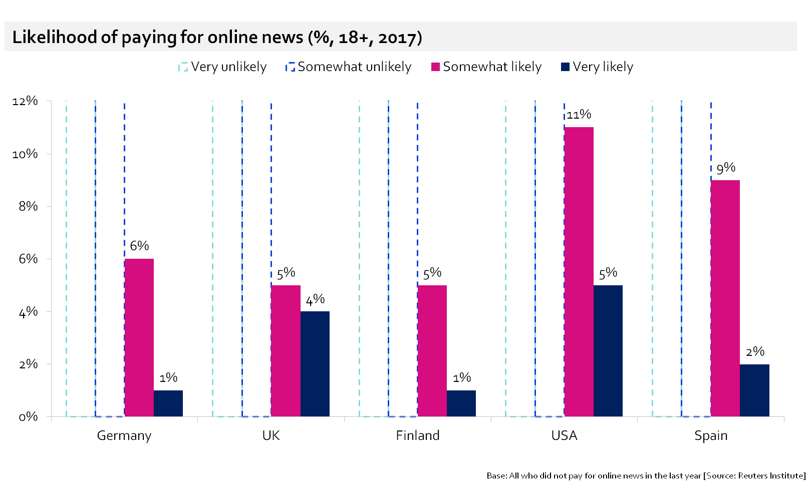
At least 5m people in UK would pay for news
Frances Cairncross | Enders Analsyis | September 2018
26

Slide 27
More good news….
Digital media offer many new ways to collect and distribute news
They also offer new ways to hold politicians to account
Online news services don’t carry the costs of printing and distribution paper
High quality online news is available to anyone with internet access

Slide 28
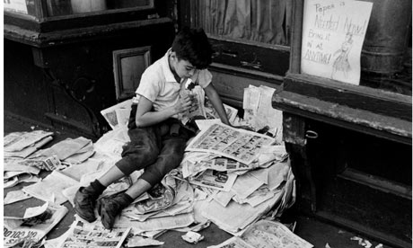
Thank you!

